Slide 1

IMPLEMENTING MACHINE LEARNING IN DevOps
Idea-MlOps
Pranali Dhole- i355753
Mithun – i355604
Gowtham Potureddi – i355737

Slide 2
Description of idea
Identification of Root Cause:
Root Cause is the exception of application quality, letting teams fix an availability or performance issue once and for all.
Using machine Learning we can train the system to classify all the possible ways to how a system gets fail and predict the possible root cause that can be triggering the failure.
Predict the release time of a product:
While predicting the release time of product there might be some delay due to unknown errors, application failures, bugs etc. So by extracting that we can use supervised learning and use training data in order to estimate delay of delivery and add it to existing in order to predict release time.
Monitoring the performance of developers on Realtime dashboard:
Real time monitoring of developers with respect performance for management level.
In order to get insights of team.

Slide 3
DevOps
We can get a lot of data from DevOps.
We use a lot of tools in a pipeline, automating almost all the process.
When ever a developer is submitting his code we send it through all needed step to make sure his code is perfect.
The latest code in the code line will be integrated continuously and it is called Continues Integration.
The integrated code is later sent through deployment stage and that is called Continues Deployment.

Slide 4
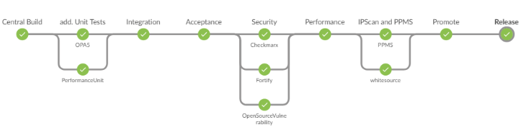

GitHub Code
Logs →
Huge Data →

Slide 5
Data that we can get from logs
Jenkins
Build Number
Username who triggered the pipeline
Duration
Pipeline Status: PASS/FAIL
If failed, at which stage
Error
Tools
SonarQube : Bugs, Vulnerabilities, Code Smells, Debts, Duplications, LOC
CheckMarx: Exploitability, Weakness Prevalence, Weakness Detectability, Technical Impact, Business Impact, Issues Found
WhiteSource: Policy compliance scan results
OPA5 results

Slide 6
Data that we can get from logs
JIRA
Jira ID
User associated
Status
Description
How much time a bug/backlog took to resolve?
Priority
Github
Commit Id
Commit Message
Etc..

Slide 7
ROOT CAUSE ANALYSIS
Root Cause is the exception of application quality, letting teams fix an availability or performance issue once and for all.
Often teams don't fully investigate failures and other issues because they are focused on getting back online. If a reboot gets them back up, then the root cause gets lost.
When ever a failure is happened or even before failure happens we can predict and suggest dev team regarding the Root cause of the failure.
So we can either prevent the failure or make sure that particular root cause wont be a reason for failure again.

Slide 8
What might be the cause
Log5
(Etc.)
Log1
(OPA5)
Stopped
(or)
About to Fail
Machine Learning
ROOT CAUSE
Log2
(SonarQube)
Log3
(CheckMarx)
Log4
(WhiteSource)

Slide 9
Predict the release time of a product:
Successful DevOps practices generate large amounts of data, so it is unsurprising that this data can be used for such things as streamlining workflows and orchestration, monitoring in production, and diagnosis of faults or other issues.
Following parameters can be considered in order to predict the release of a product:
Defect priority
Code coverage
Jira user story status
Percent of automation
Jenkins Logs

Slide 10
Predict the release time of a product:
To achieve this, in addition to above-mentioned parameters we will capture :
Number of developers in a team
Lines of code
No of files
Total defects
The program will train a regression model to predict the release time as the output of these input parameters. Using this trained model we can predict the release time at any given time

Slide 11
Expected release time
(1 week)
Code coverage
Jira user story status
Jenkins Logs
Defect priority
Number of developers in a team
And other parameters
Machine learning (regression)
Expected release
(+ | -)
Predicted duration
Predicted duration

Slide 12
Monitoring the performance of developers on Realtime dashboard:
As we know the concept of CICD, it needs continous delievery within a period of time.
In such cases, the quallity of code and the performae of developer matters a lot.
In order to analyse the team performance and individual developer performance in real time
we thought of using machine learnig algorithms on the logs of data that we get from jenkins, seurity tools, jir and github.
Mapping this data can provide insights in whats happening in the team.
Following things can be monitored on the regular basis :
Quality of code by the developer.
How actively the developer is pushing the code to GitHub
After pushing the code, whether the developer code is good enough to pass the Jenkins pipeline.
Based on the severity of bug or task, how much time does the developer take to fix it can also determine the performance of the developer.

Slide 13
THANK YOU

